Slide 1
Real-time carbon footprints and energy system modeling at the University of Iowa
Interdisciplinary independent study with the departments of computer science, civil & environmental engineering, and ENGIE

Slide 2

Building Carbon Footprints

Slide 3
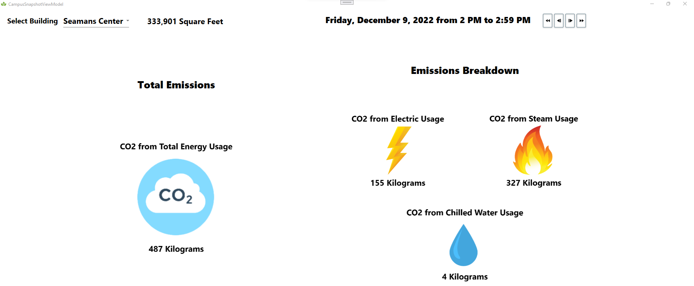

Slide 4

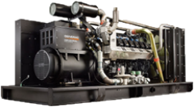



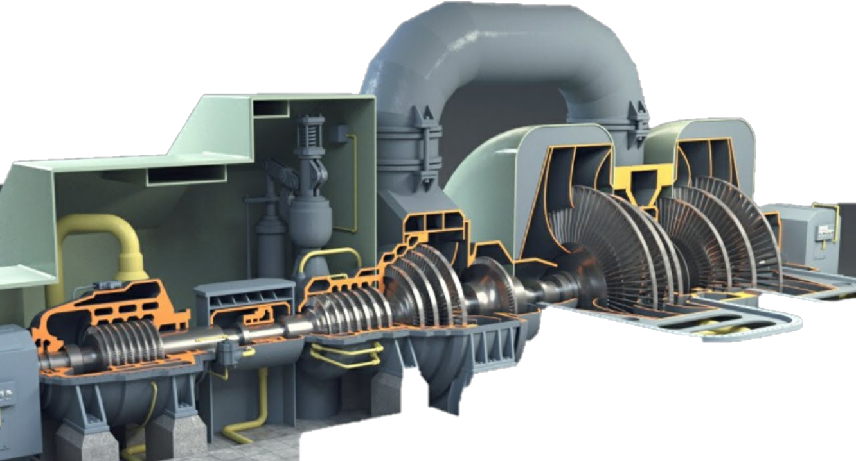



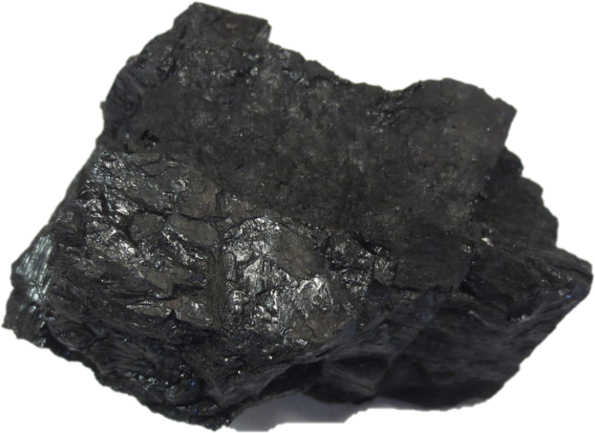

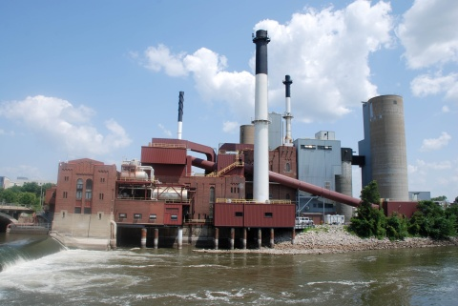

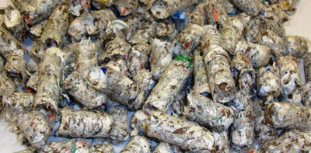


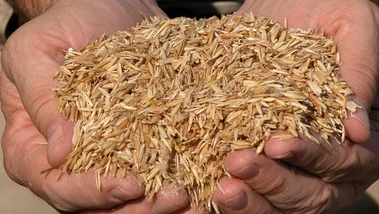

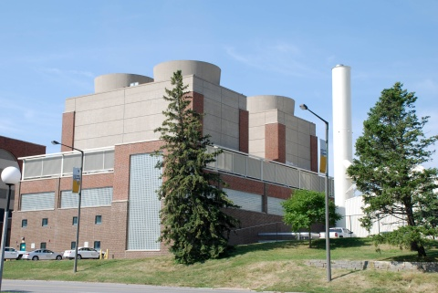

Slide 5
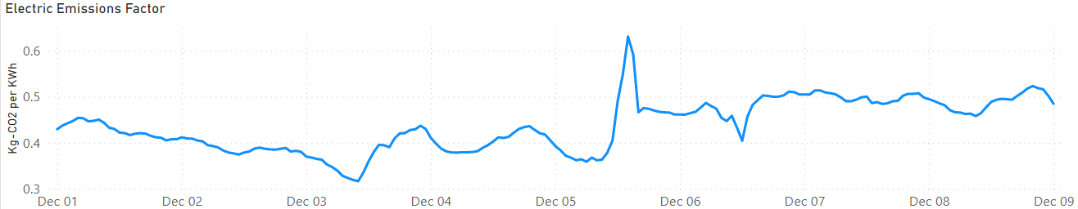
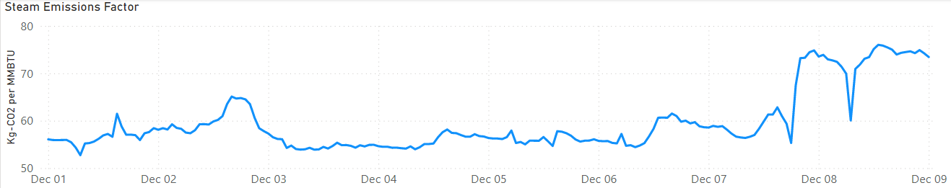
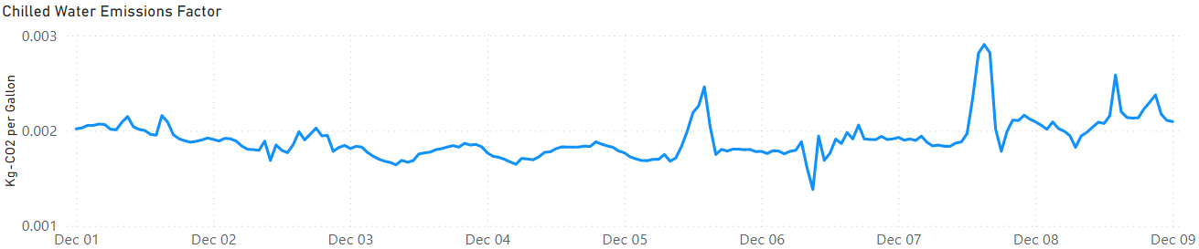
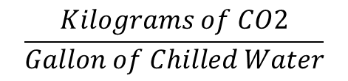
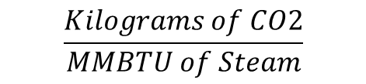
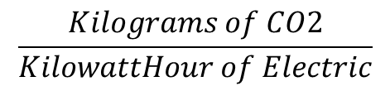
Energy Resource Metrics
$$\frac{Kilograms of CO2}{KilowattHour of Electric}$$
$$\frac{Kilograms of CO2}{MMBTU of Steam}$$
$$\frac{Kilograms of CO2}{Gallon of Chilled Water}$$

Slide 6
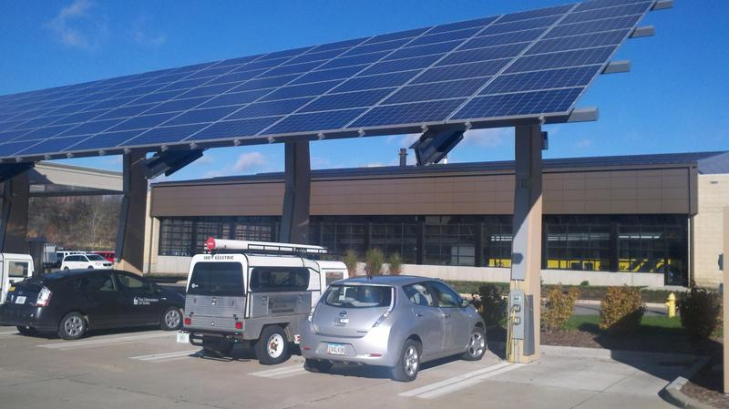

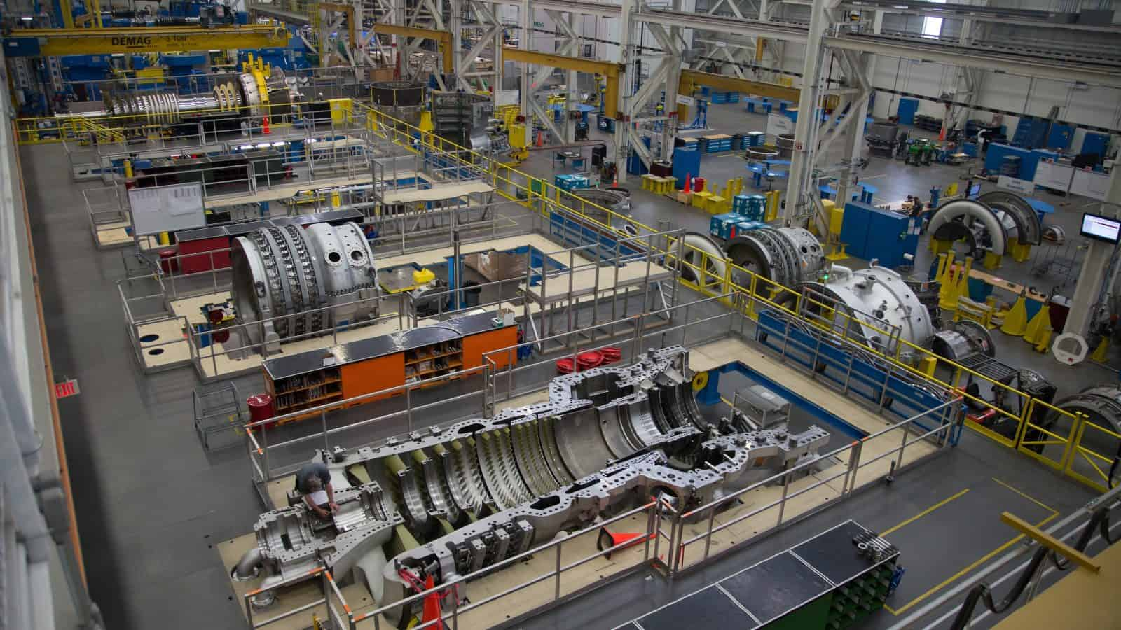
Carbon-Based Load Shifting
Energy intensive processes that have temporal flexibility
Vehicle charging
Heating/Cooling (to some degree)
Computational and Manufacturing processes
[1] Noman Bashir, Tian Guo, Mohammad Hajiesmaili, David Irwin, Prashant Shenoy, Ramesh Sitaraman, Abel Souza, and Adam Wierman. 2021. Enabling Sustainable Clouds: The Case for Virtualizing the Energy System. In Proceedings of the ACM Symposium on Cloud Computing (SoCC '21). Association for Computing Machinery, New York, NY, USA, 350–358. https://doi.org/10.1145/3472883.3487009
[2] R. Jha, S. Lee, S. Iyengar, M. H. Hajiesmaili, D. Irwin, και P. Shenoy, ‘Emission-Aware Energy Storage Scheduling for a Greener Grid’, στο Proceedings of the Eleventh ACM International Conference on Future Energy Systems, Virtual Event, Australia, 2020, σσ. 363–373.

Slide 7
Process Scheduling
Assume a process that requires the following energy resources
20 MMBTU’s of Steam
5 MWH
5000 gallons of chilled water
What are the best and worst times to perform this process in terms of carbon emissions?

Slide 8
Process Scheduling
Saves 1.59 Metric Tons of CO2!
$$\frac{Kilograms of CO2}{KilowattHour of Electric}$$
2.67 Metric Tons of CO2
4.26 Metric Tons of CO2
$$\frac{Kilograms of CO2}{MMBTU of Steam}$$
$$\frac{Kilograms of CO2}{Gallon of Chilled Water}$$

Slide 9
Challenges
98 data streams needed to produce these metrics at UIowa
Some sets of streams have complex relationships
14 different units between data streams
MMBTU/hr
SCFH
MW
KLB/HR
GPM
lbs/hr
SCFM
KW
KSCF/H
“”
kscfh
pph
SCCFH
megawatthours
Notes:
[0]: "MMBtu/hr"
[1]: "KSCF/H"
[2]: "SCFH"
[3]: "lbs/hr"
[4]: "KLB/HR"
[5]: "kscfh"
[6]: "pph"
[7]: "MMBTU/HR"
[8]: "LBS/HR"
[9]: "KSCFH"
[10]: "KLBS/HR"
[11]: "SCCFH"
[12]: "MW"
[13]: "SCFM"
[14]: "KW"
[15]: "megawatthours"
[16]: ""
[17]: "GPM"

Slide 10
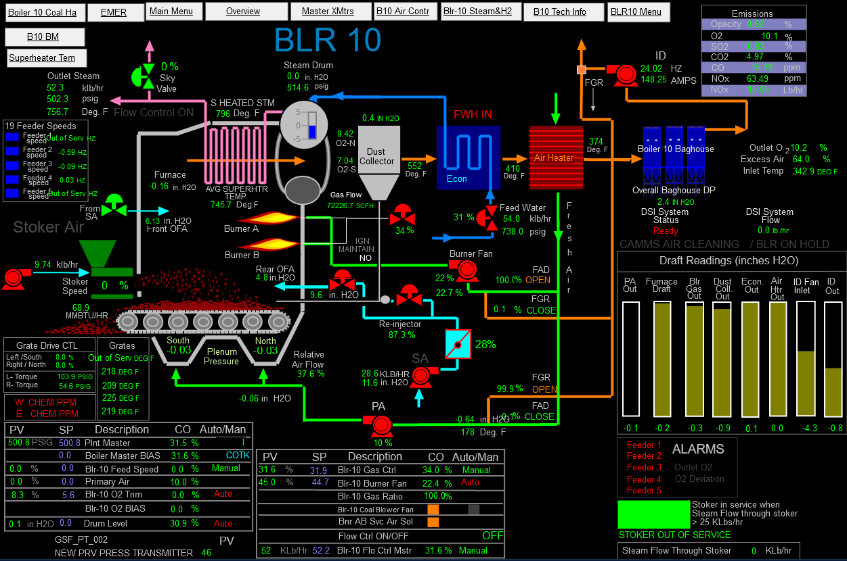

Slide 11


Modeling Layer
{ f(data) }

Slide 12
Modeling Layer
f
f
f
f
f
f
f
f
f
f
f
f
f
f
f
f
f
f
f
f

Slide 13


Technical Information
Written in C# using the .NET 7 application framework
System Includes:
Unified Data Explorer Desktop Application
Model Designer
Data Explorer
Building Reports
Web API
Experimentation Console Application and Power BI dashboard
SQL Server Database
Code Available on GitHub!
https://github.com/ryan-policheri/DynamicEmissionsModeler

Slide 14
Software Demo

Slide 15
Accuracy Test
ENGIE’s 2021 Power Plant Scope 1 CO2 emissions figures, used for EPA reporting.
195,851 Metric Tons of CO2

Slide 16
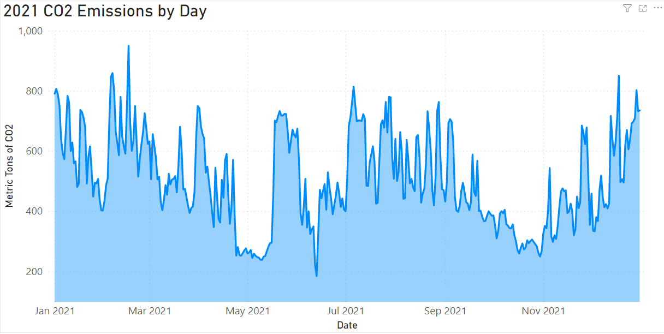
Accuracy Test
Modeling software’s version of the same calculation contains 5.8 % error
184,480 Metric Tons of CO2

Slide 17
Experimentation
f
f
f
f
f
f
f
f
f
f
f
f
f
f
f
f
f
f
f
f
f

Slide 18
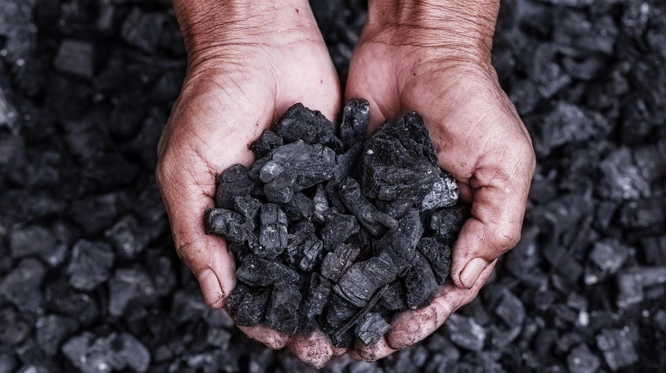
No Coal by 2025
Fuel Comparison
Coal
Energy Pellets
1.02 Kg-CO2 per pound burned
10,940 BTUs per pound
$0.041 per pound
Details: Bituminous
0.61 Kg-CO2 per pound burned
9,529 BTUs per pound
$0.048 per pound
Details: %57.5 Biomass, %42.5 Pre-Consumer Plastics

Slide 19
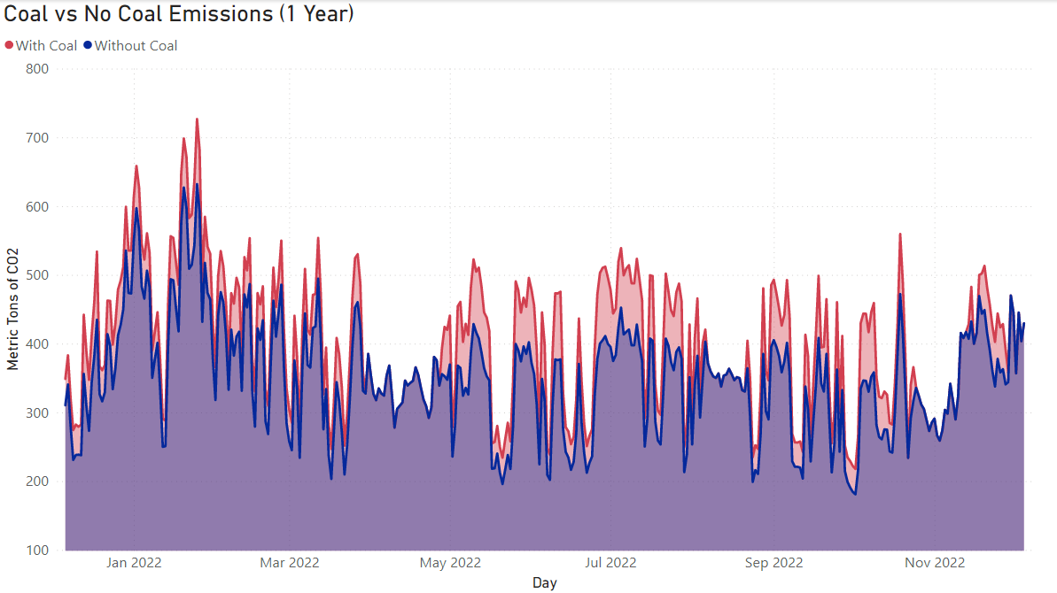
Replacing Coal with Energy Pellets
18,220 Metric Tons of CO2 Prevented! (%12.5 decrease)

Slide 20
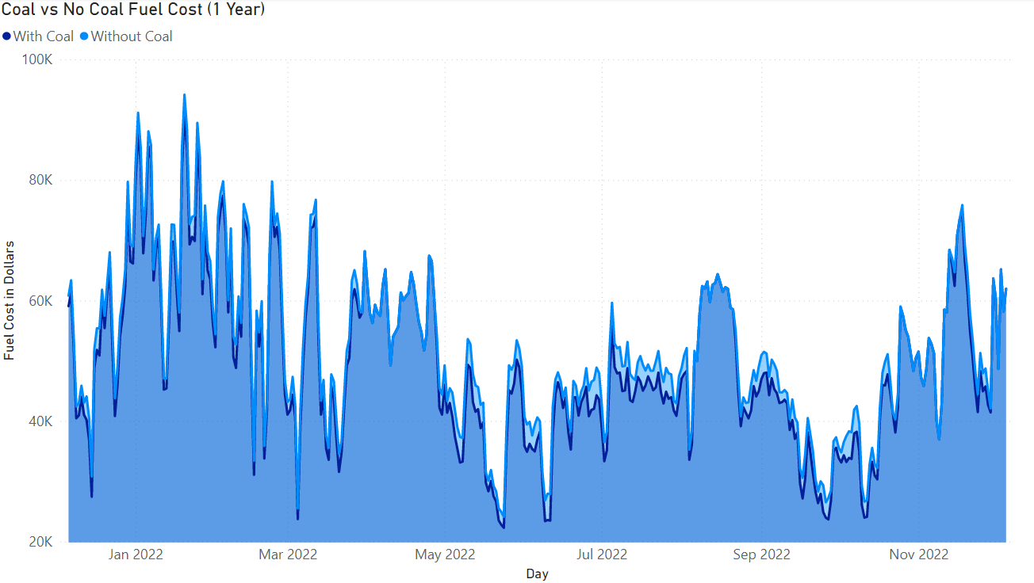
Replacing Coal with Energy Pellets
$827,549 more in Fuel Costs (4.4 percent increase)

Slide 21

Social Cost of Carbon
[3] Estimated the $185 to be the social cost per metric ton of CO2 emissions
Current U.S. administration prices $51 per metric ton
Establishing a carbon market at the current U.S. price would net yield the following profit:
18,220 tons CO2 prevented * $51 - $827,549 = $101,671
[3] Rennert, K., Errickson, F., Prest, B.C. et al. Comprehensive evidence implies a higher social cost of CO₂. Nature 610, 687–692 (2022). https://doi.org/10.1038/s41586-022-05224-9

Slide 22
No Coal by 2025
Fuel Comparison
Coal
Oat Hulls
1.02 Kg-CO2 per pound burned
10,940 BTUs per pound
93.28 Kg-CO2 per MMBTU
$0.041 per pound
“0” Kg-CO2 per pound burned
7,214 BTUs per pound
“0” Kg-CO2 per MMBTU
$0.031 per pound

Slide 23
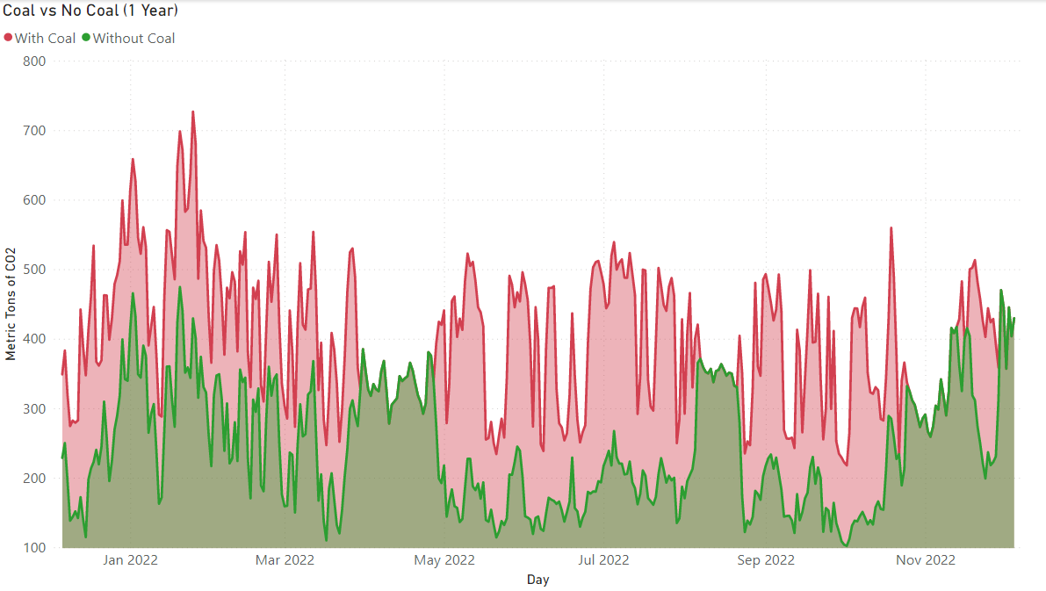
Replacing Coal with Oat Hulls
57,180 Metric Tons of CO2 Prevented! (%39.2 decrease)

Slide 24
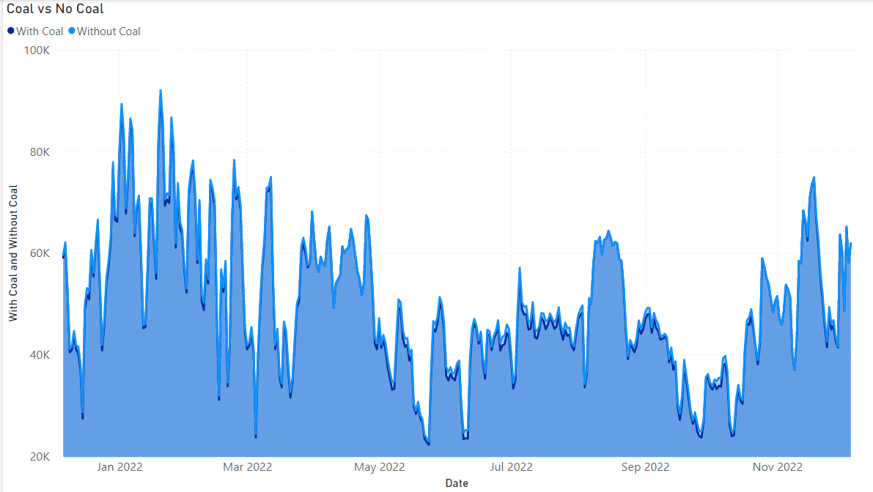
Replacing Coal with Oat Hulls
$300,369 more in Fuel Costs (1.7 percent increase)

Slide 25
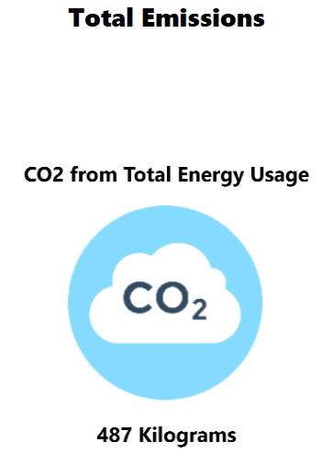
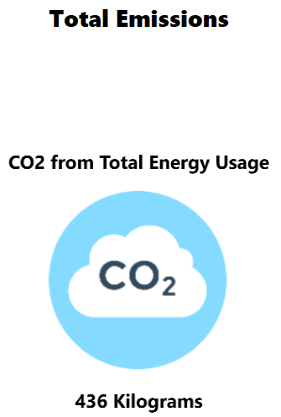
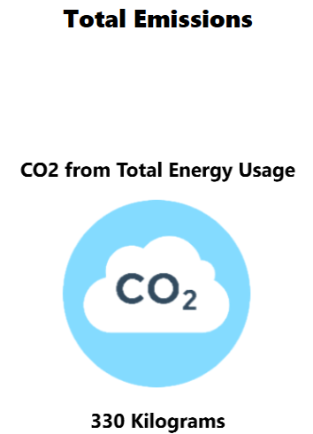
With Coal
Pellets over Coal
Oat Hulls over Coal

Slide 26
Special Thanks To
George Paterson and Melissa Gilmartin from ENGIE, Jerry Schnoor, and the Department of Computer Science!

Slide 27
Questions?

